Slide 1
Dog Breed Classification
Written By
Jaki Tang,
Jolina Shen,
William Dai

Slide 2



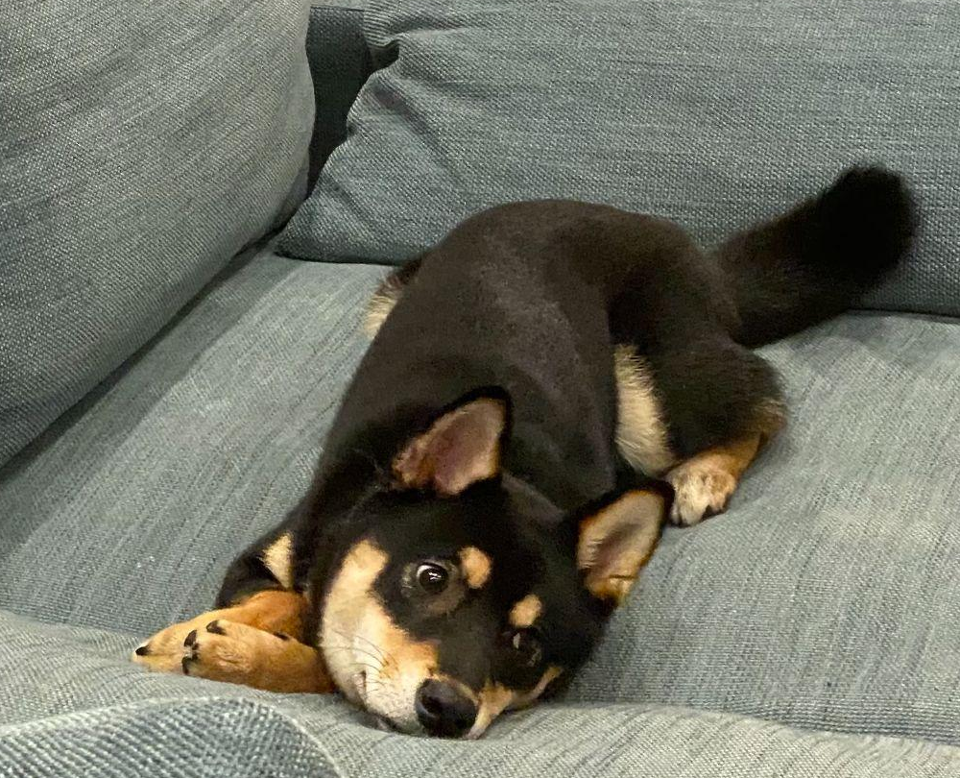
Dog Owners Introduction
Owner of a Maltese and a Pomeranian
Owner of a Pomeranian
Owner of a Shiba-Inu
Jaki Tang
Jolina Shen
William Dai

Slide 3
Agenda
01
04
Problem Statement
CNN with Transfer Learning
02
05
EDA
Model Comparison
03
06
Base CNN
Findings & Future Improvements

Slide 4
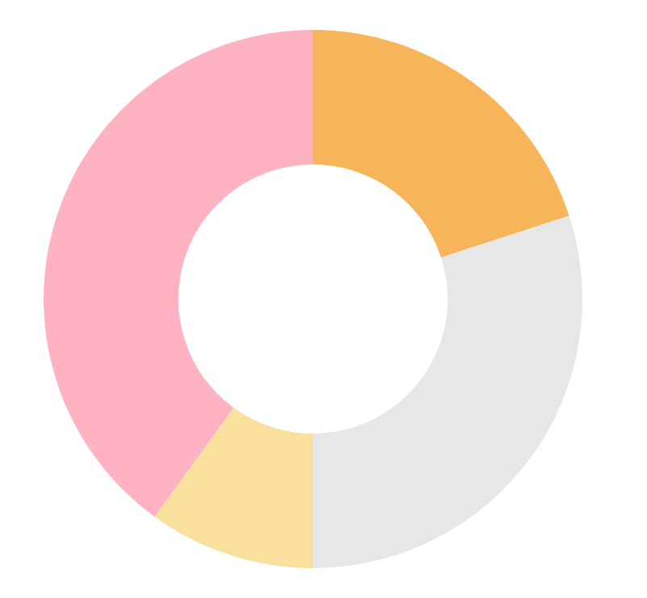
Problem Statement
Dogs have been the most favorite and popular pet of humans.
There are more than 154 dog breeds and some are similar in
face configurations.
Dogs need a specific treat due to their breed, we have to recognize dog breeds in order to appropriately care and cure.
An automatic dog breed classifier can be used as a standalone classification tool or an assistant to the experts in giving essential information for speeding up the classification process.

Slide 5
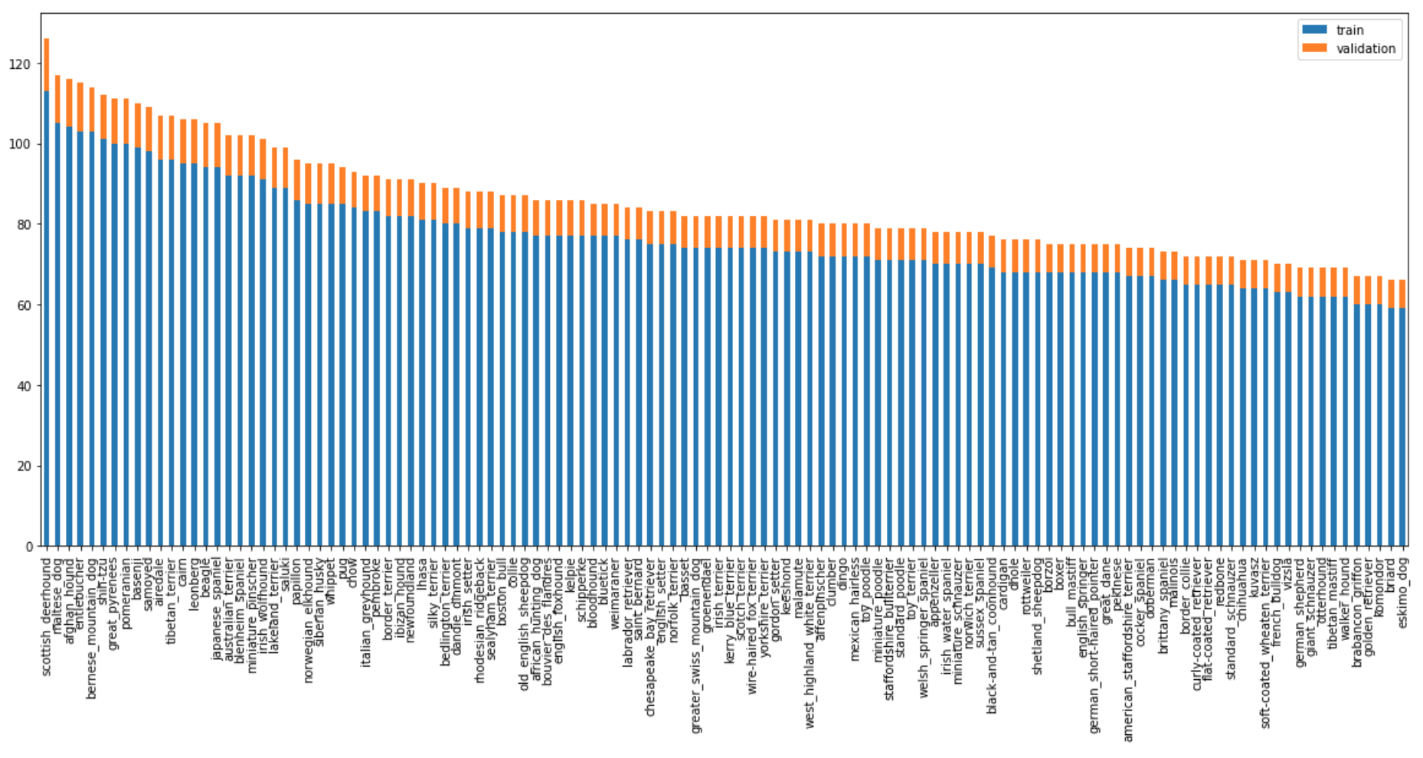
Exploratory Data Analysis
Dataset contains 120 unique labels.
Train data size: 10,222
Average images per dog breed is 85 images
Popular Breeds are: scottish deerhound, Maltese and Afghan hound

Slide 6
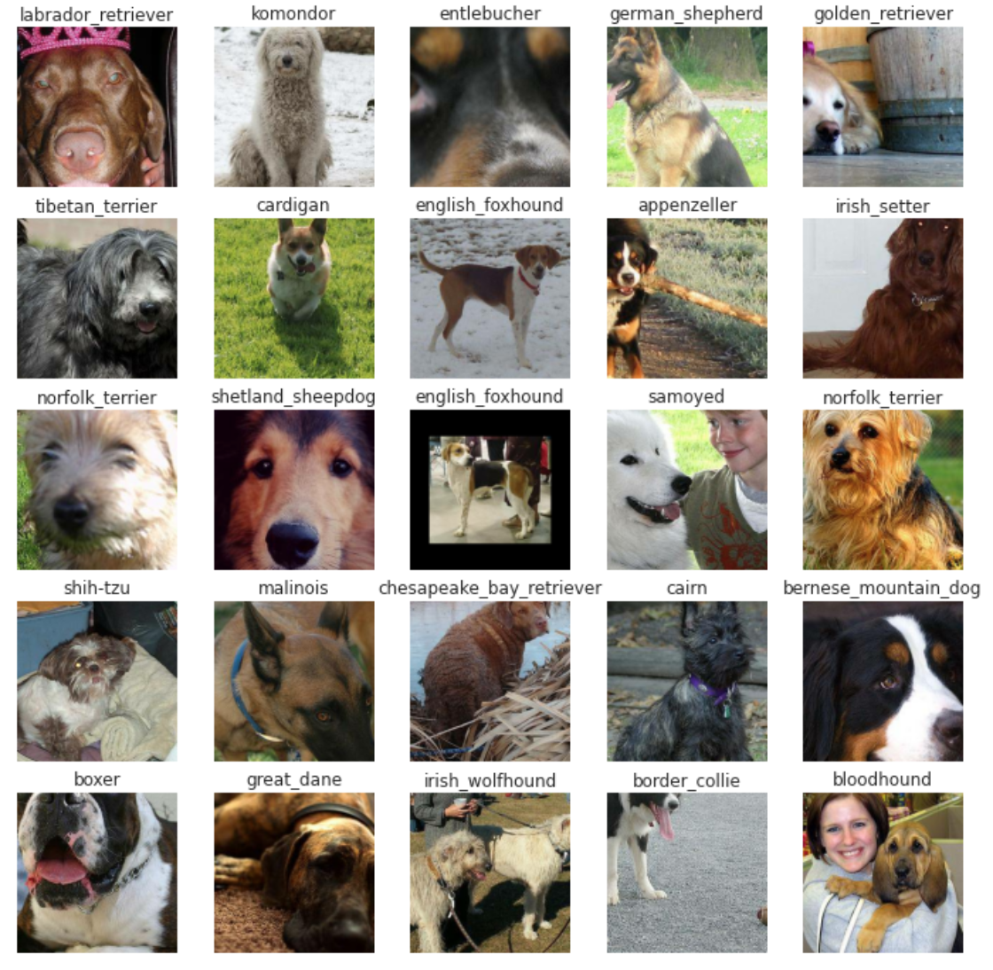
Exploratory Data Analysis
Train dataset sample
Potential problem:
Picture included human faces
Dogs only included partial faces
Different angle and position of dogs
Different color and styling
Different lighting and different pixels

Slide 7
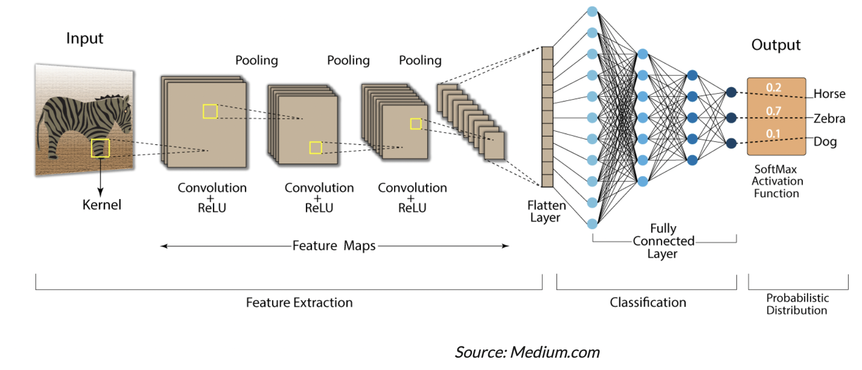
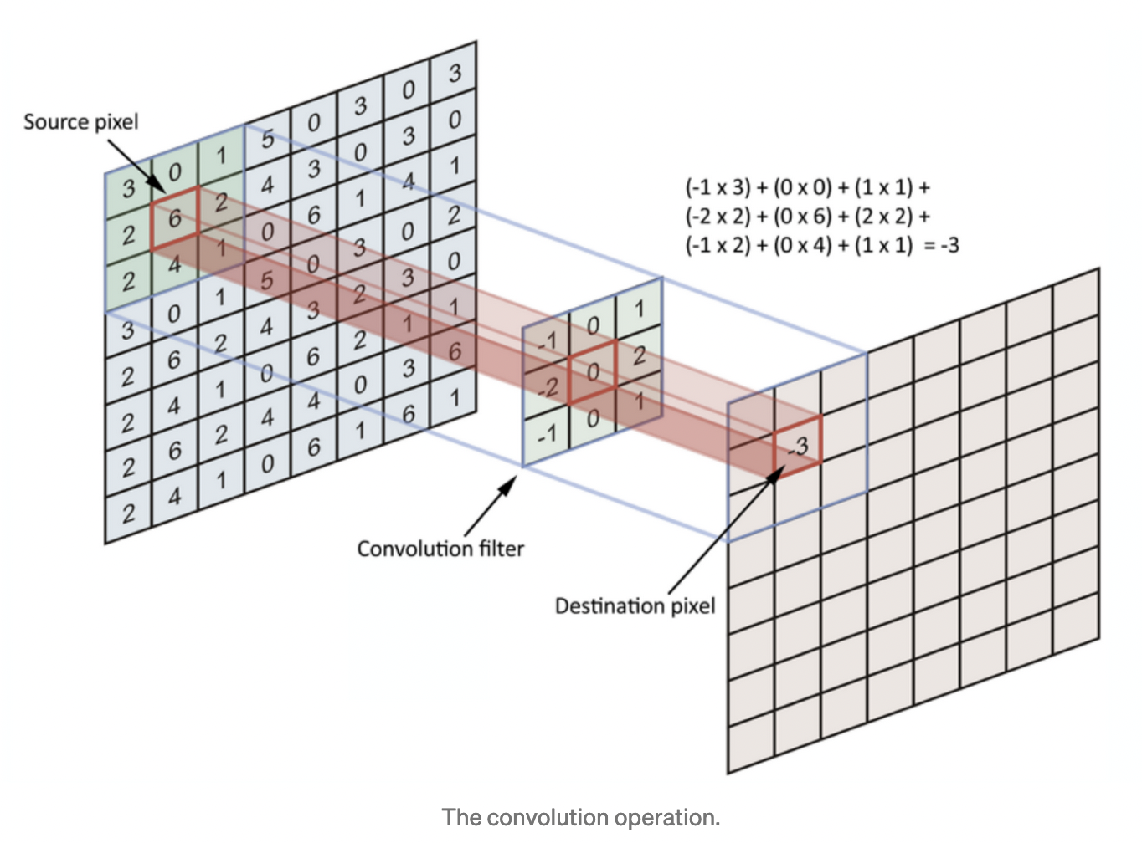
Convolutional Neural Networks
Convolutional layers are the layers where filters are applied to the original image
Convolution layer is the process of combining two functions to produce the output of the other function
Uses pooling processes to subsample the given input
Pooling layers perform a specific function,are typically used to reduce the dimensionality of the network
Fully connected layers are placed before the classification output of a CNN
Are used to flatten the results before classification
Notes:
Convolutional Neural Networks (CNNs) have an input layer, an output layer, numerous hidden layers, and millions of parameters, allowing them to learn complicated objects and patterns. Nearby pixels are strongly related than distant ones, Use filters to analyze the influence of nearby pixels

Slide 8
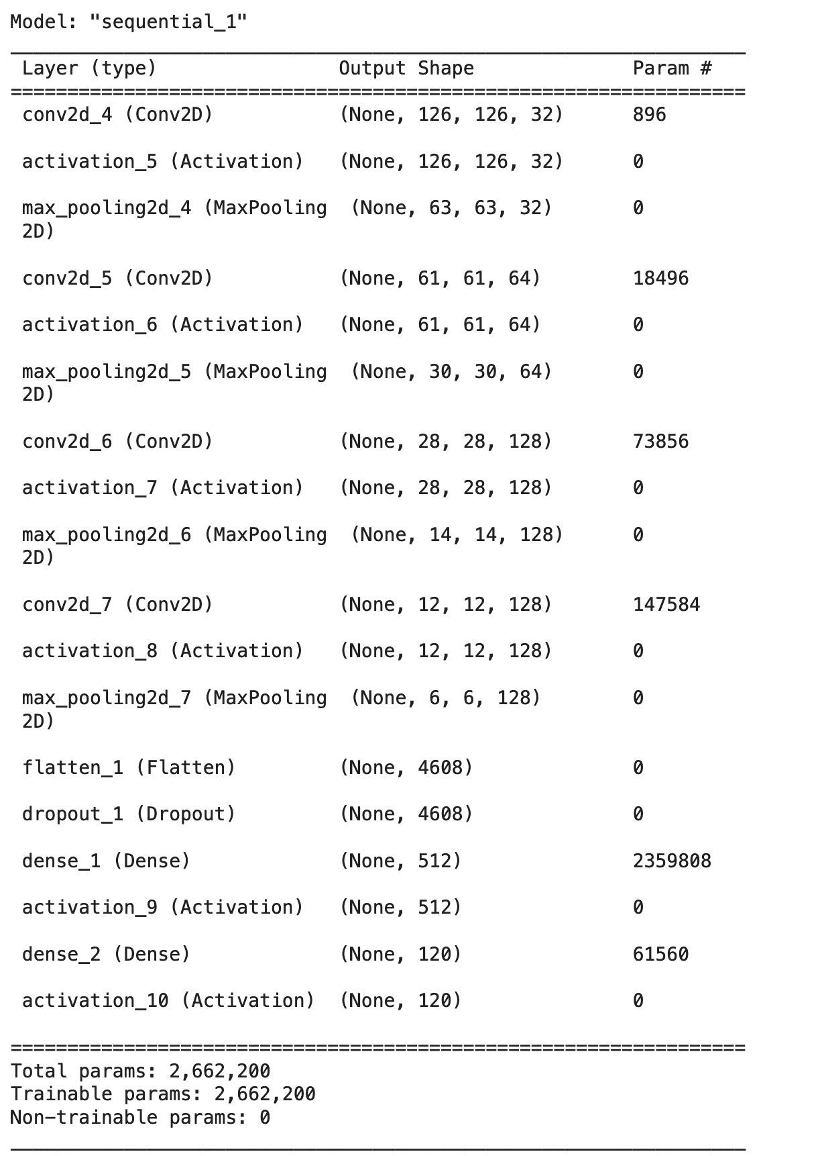
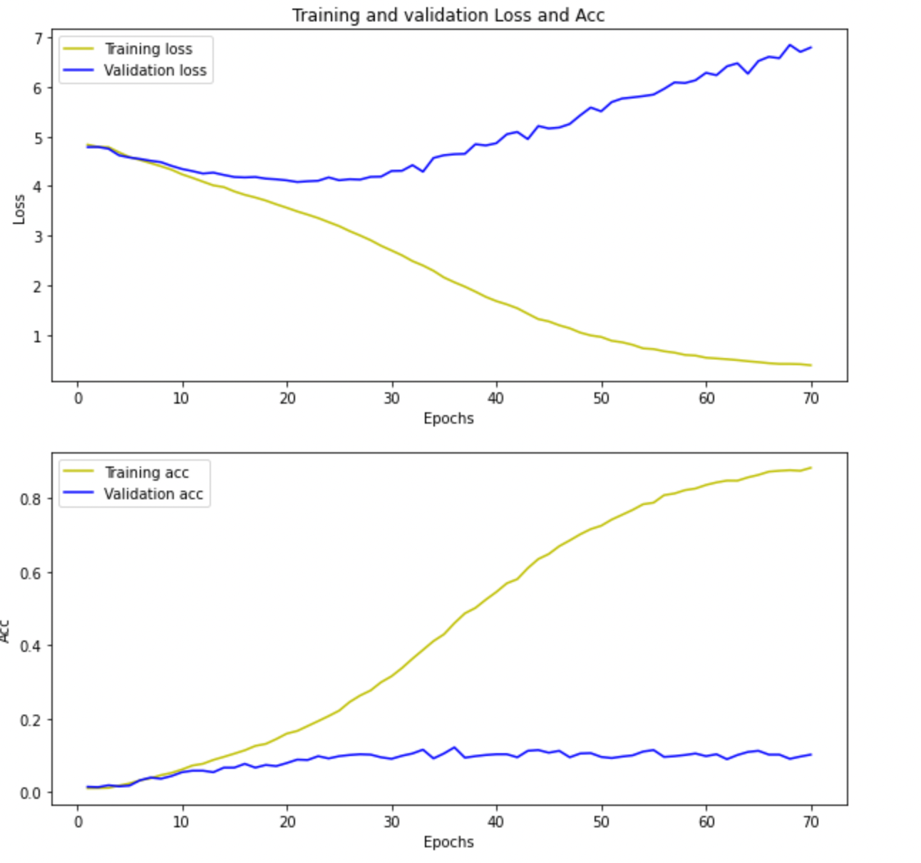
Base CNN - Result
Input layer
- 9200 Train images
- 1022 Validate image
With rescale equal to 1.0/255.0
Convolution layer
- Filter size 3x3
- Using Relu as activation function
Pooling layer
- Choose the most significant element from the feature map
Fully connected layer
- Adding dense, dropout layers with activation function of softmax
Notes:
max pooling is usually a 2 by 2 filter with a stride of 2 that returns the maximum value as it slides over the input data
Multiple convolutional layer is to creates even more abstract representations
Baseline CNN result on validation dataset is not improving against each epoch. Also, the validation loss keeps going higher. Therefore, we believe the complexity of baseline CNN is not high enough to handle this dataset

Slide 9
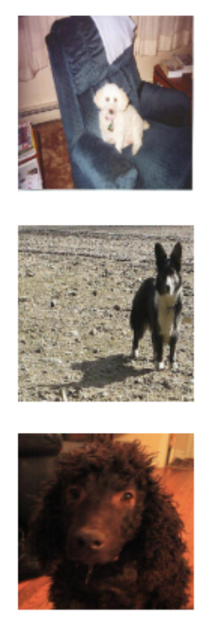
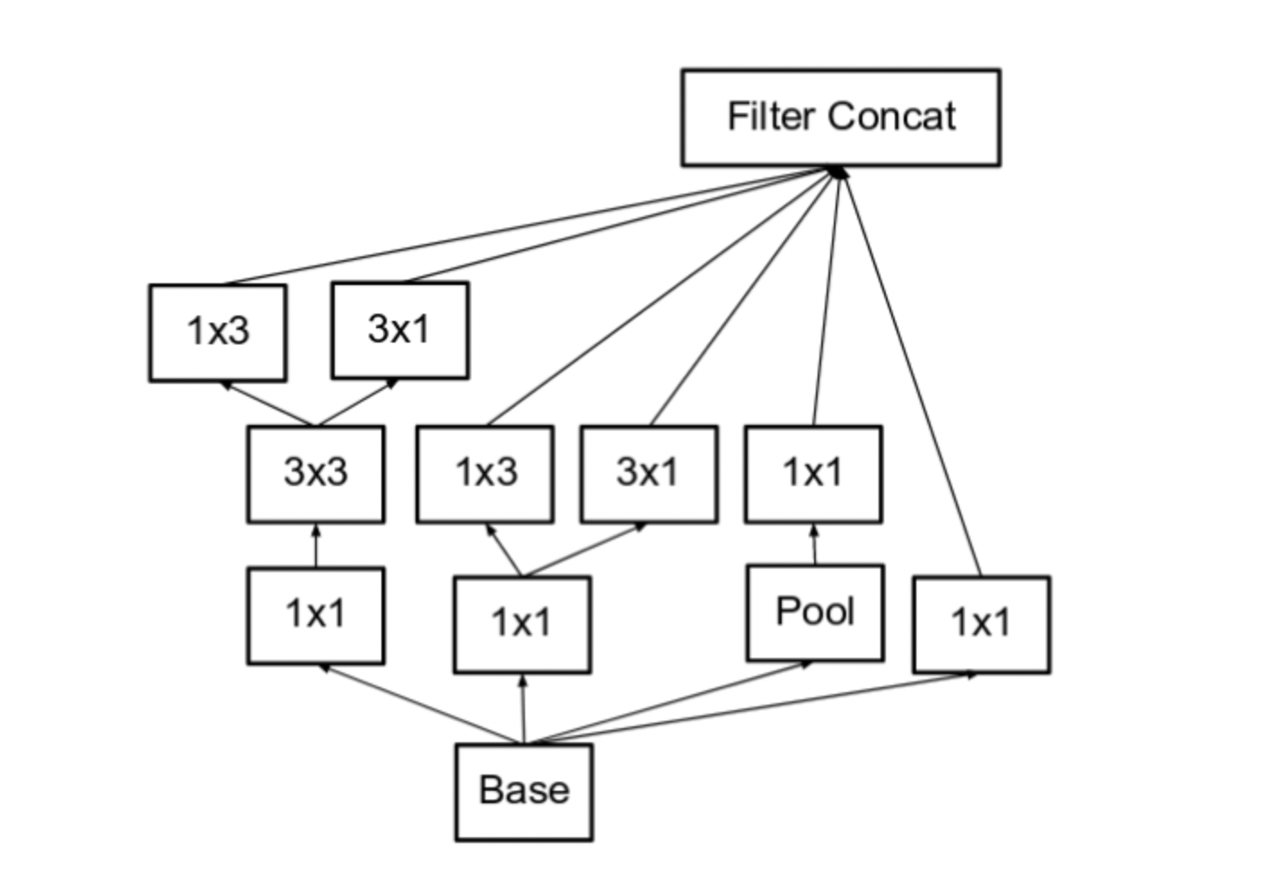
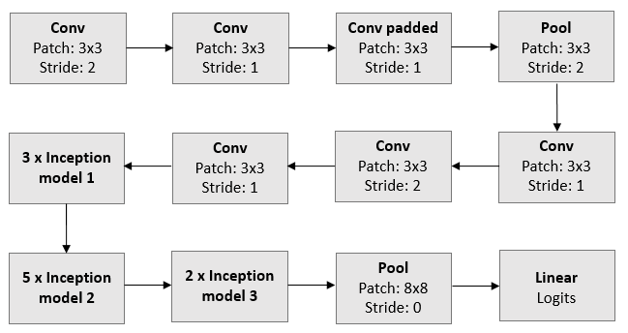
Inception V3
Reduce representational bottleneck: Inception has filters with multiple sizes operate on the same level. The network essentially would get a bit “wider” rather than “deeper”
Enhance training speed: Compared to V1, Inception V3 factorizes 5x5 convolution to two 3x3 convolution operations and further factorizes nxn to a combination of 1xn and nx1 convolution
Prevent Overfitting: Inception V3 incorporates a type of regularizing component added to the loss formula that prevents the network from becoming too confident about a class
Notes:
Salient parts in the image can have extremely large variation in size. For instance, an image with a dog can be either of the following, as shown in the left. The area occupied by the dog is different in each image.

Slide 10
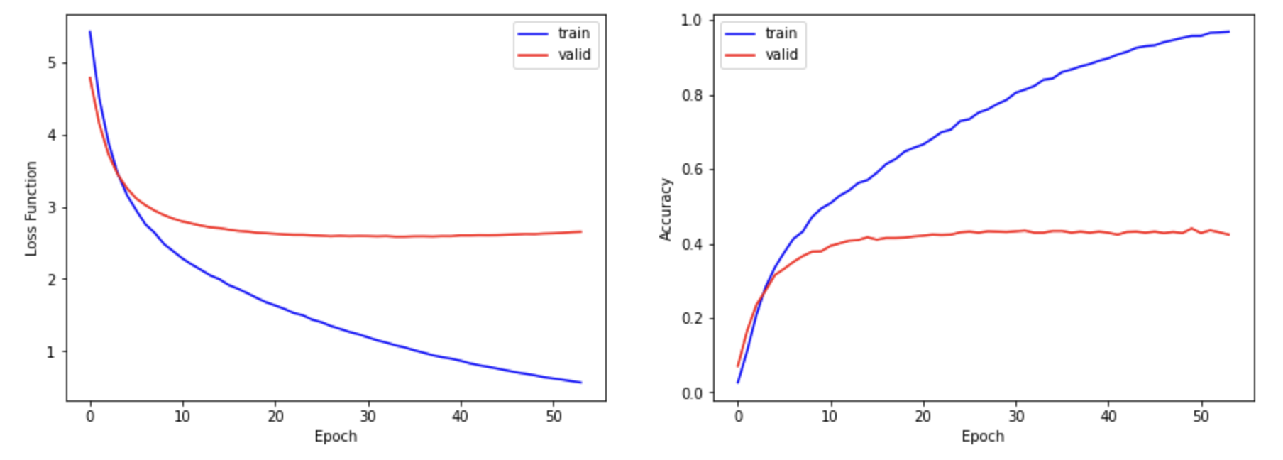
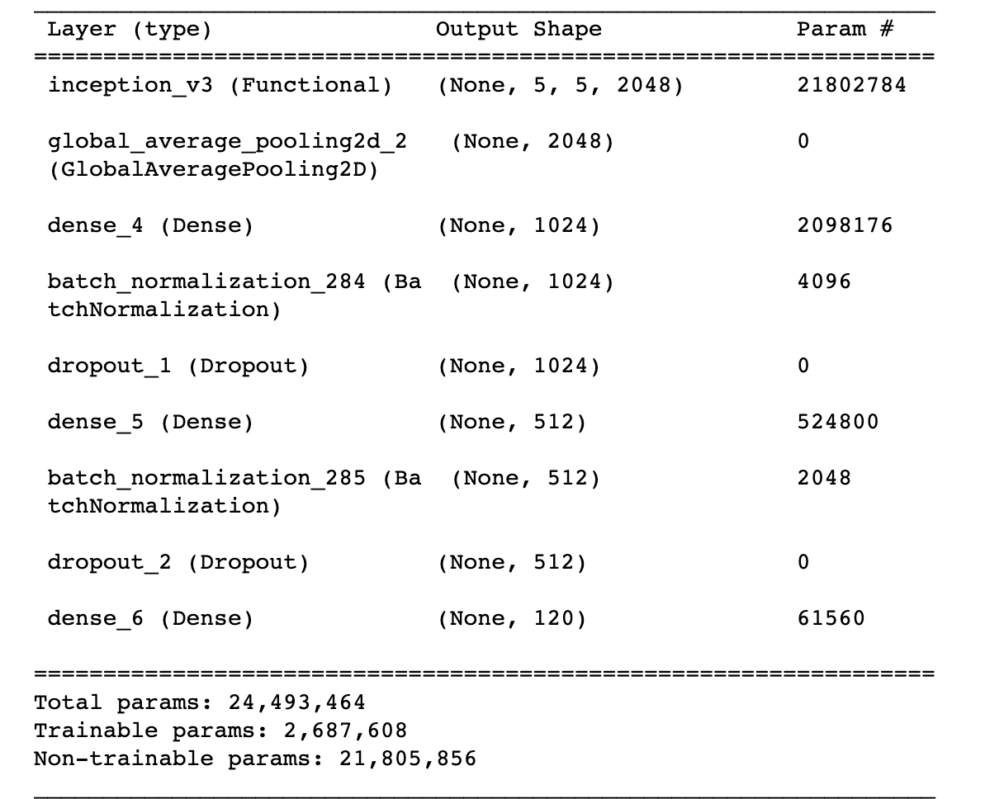
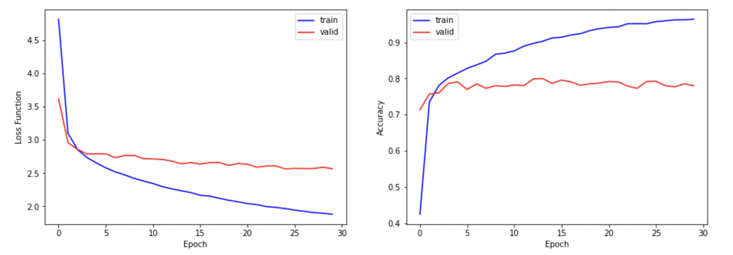
Inception V3 - Results
 | Train Accuracy: 96.91% Validation Accuracy: 78.96%
 | Activation Function: Softmax Optimizer: Adam
 | Dropout Rate: 0.25 Weight Regularization: L2
 | Preprocess: 1.0/255.0 normalization
Normalization

Slide 11
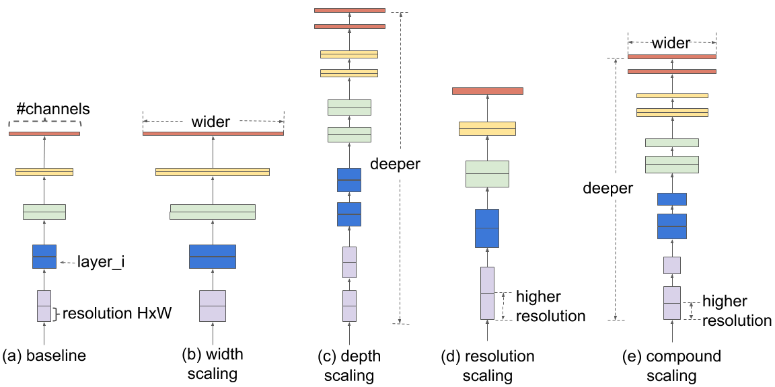
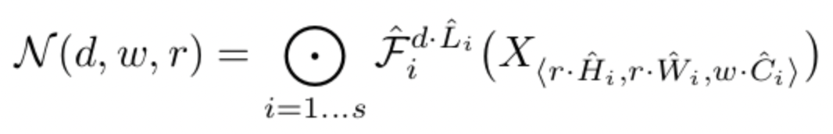
Efficient Net - ​Scaling Method
Compound Coefficient:
The compound scaling balances the dimensions of width, depth, and higher resolution in one structured design with fixed coefficients.

Slide 12
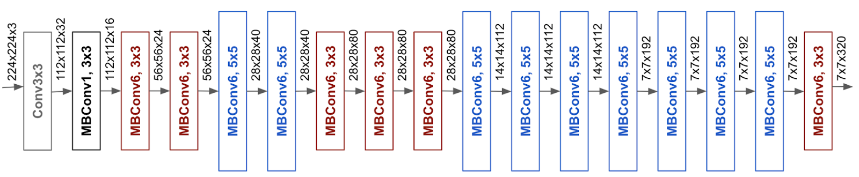
Efficient Net - Design
Design of Efficient Net is based on blocks called MBConv similar to inverted residual blocks used in MobileNet v2.
It increases the efficiency by reducing the parameters and FLOPS (Floating Point Operations Per Second) manifold.
0.39B FLOPS VS ResNet50’s 4.1B FLOPS on ImageNet
It increases the accuracy by compound scaling.
77.3% accuracy VS ResNet50’s 76% accuracy on ImageNet

Slide 13
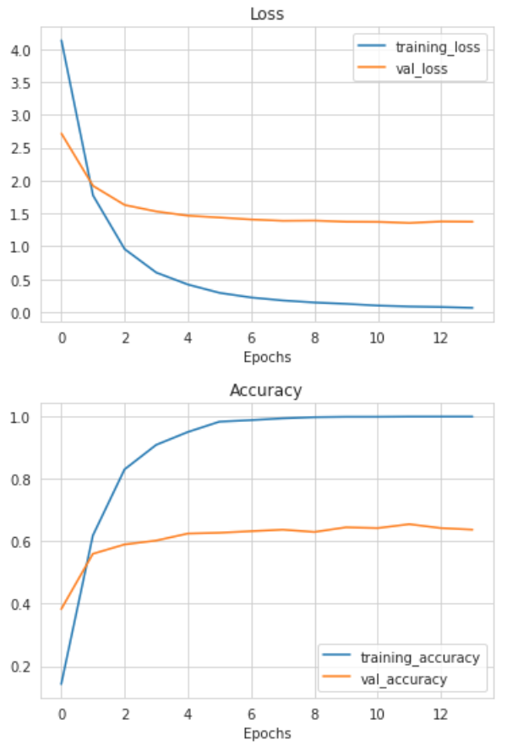
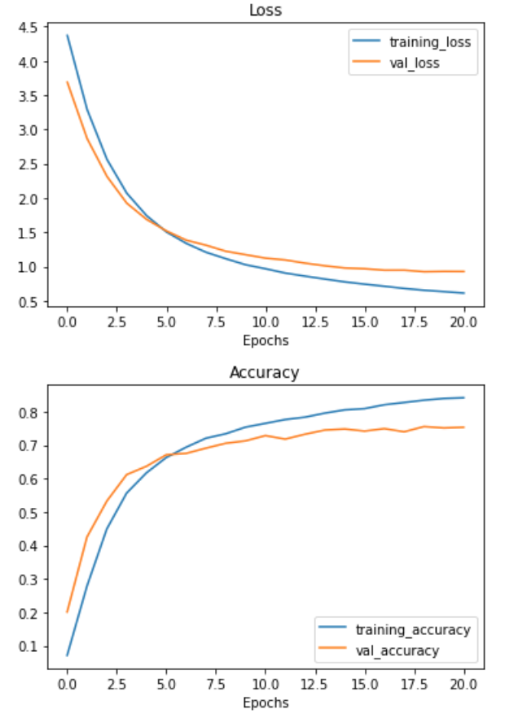
Efficient Net - Performance
99.94% Training Accuracy
79.49% Validation Accuracy
Adam Optimizer
Learning Rate: 0.0005
Decay: 1e-6
Normalization
Activation Function SoftMax
Dropout Rate: 0.1
Weight Regularization: L2

Slide 14

Recap & Discussion of Finding
Baseline CNN
Test Acc 88%,
Validate Acc 10%
Efficient Net B0
After image preprocessing
Test Acc 99.94%,
Validate Acc 79.49%
Validation Prediction is not improving against each epoch. — Need more complexity to the model
Inception V3 After image preprocessing
Test Acc 96.91%, Validate Acc 78.96%
Refines the scaling of all dimensions of the neural network like width, depth, and image resolution against the current CNNs to improve the overall performance
Contains multiple kernels with different sizes so that objects of various sizes can be captured from the previous layer

Slide 15
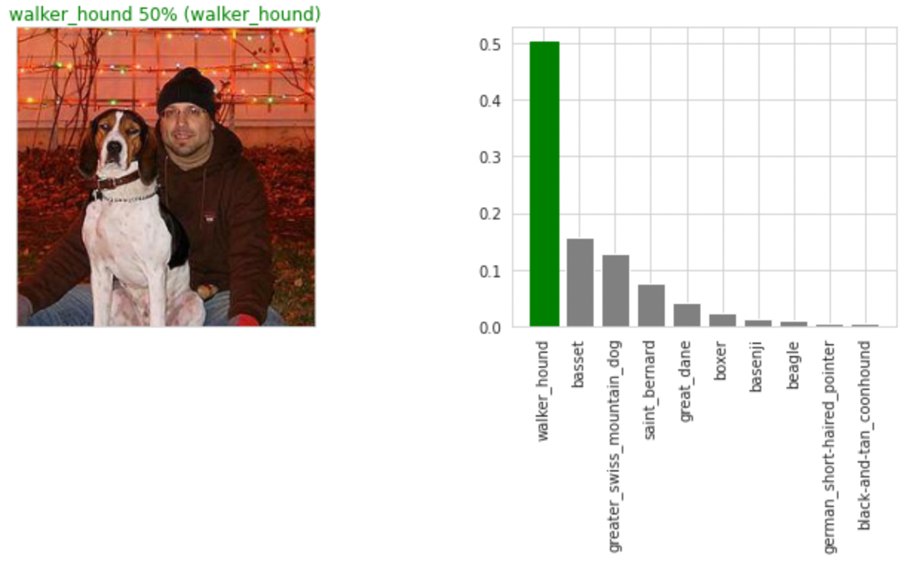
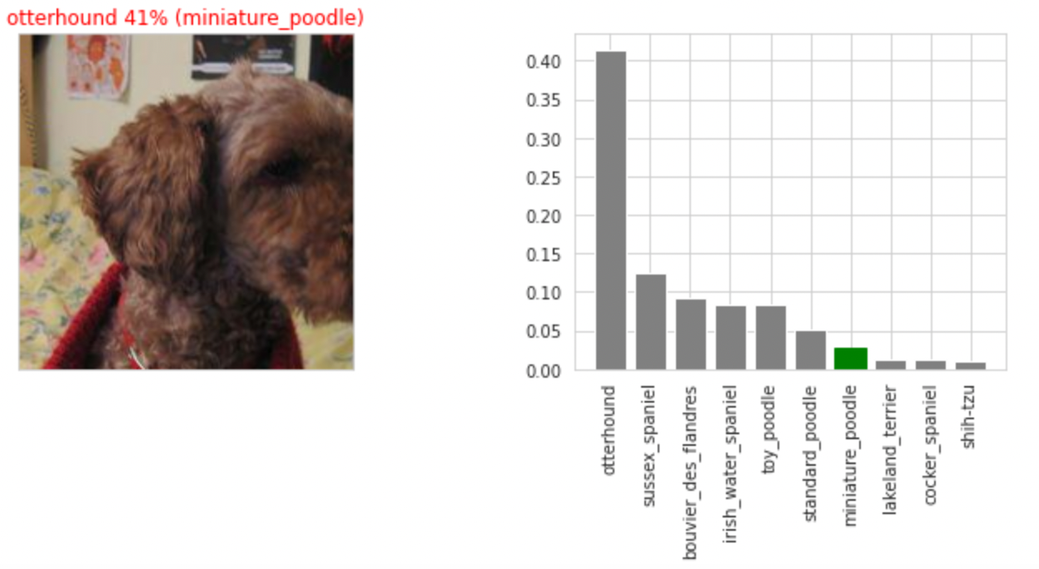
Conclusion & Result
Good Prediction
Bad Prediction

Slide 16
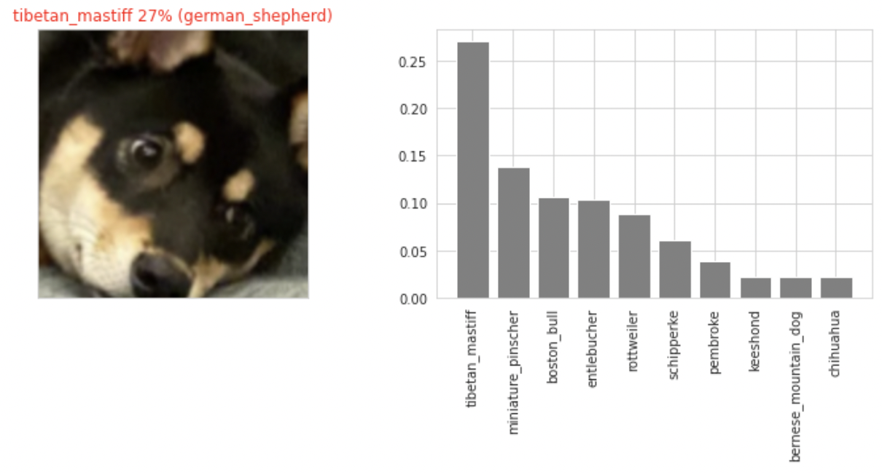
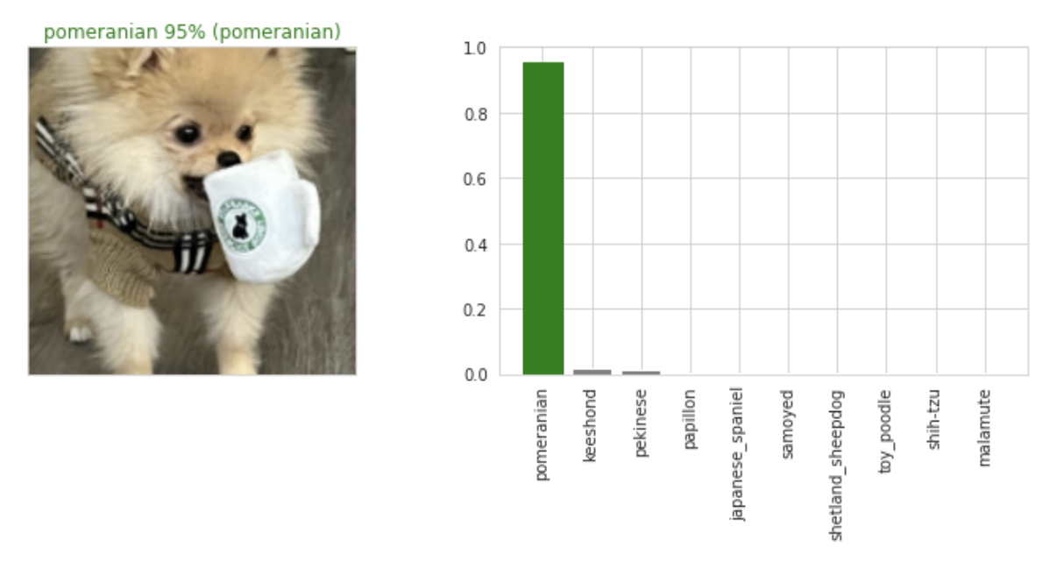
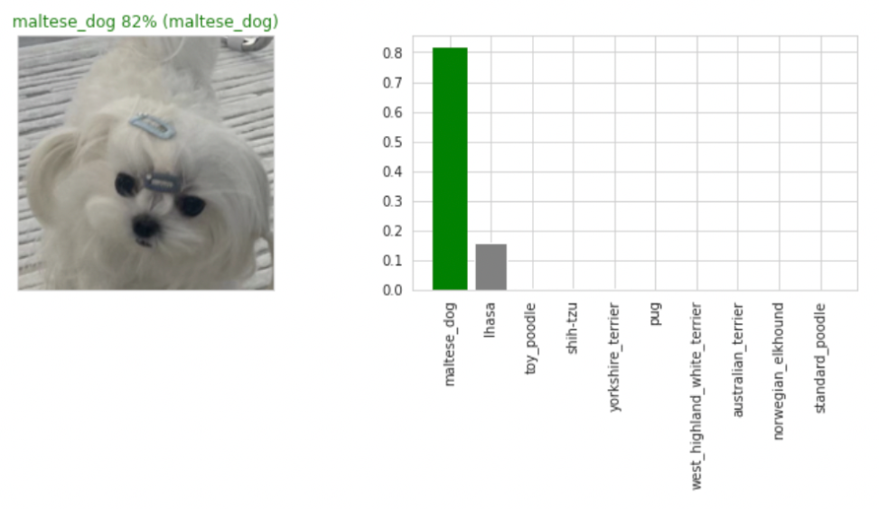
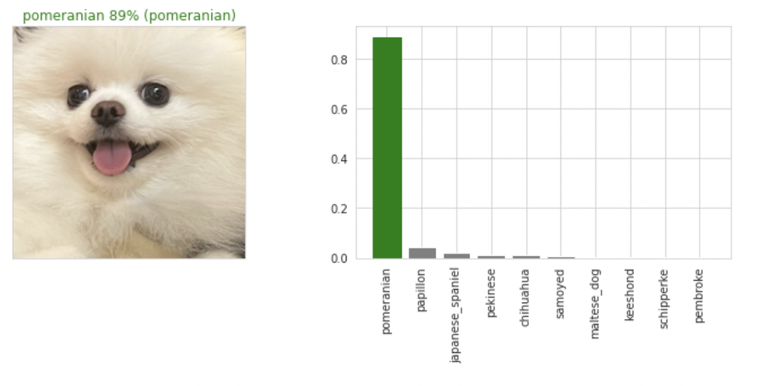
Real-Life Image Test
Does the model work for our dogs?

Slide 17
Future Improvement
 | Data Augmentation: leverage Generative adversarial networks (GANs) to generate synthetic data to achieve better training and validation results
 | Ensemble Transfer Learning: Training multiple diverse models instead of a single model to combine the predictions. This may potentially reduce the variance of predictions and reduce generalization errors
 | Update version from EfficientNetB0 to EfficientNetB7. Update version from InceptionV3 to InceptionV4/Inception-ResNetV2.
Notes:
Puppies VS Adult Dogs?

Slide 18
Thank you!
Q&A

